Slide 1
ML PROJECT
Maham Nisar
2023-BS-AI-058

Slide 2
PROJECT 01
Linear Regression Ecommerce Customer Behavior

Slide 3



ERE
Introduction
Dataset: Ecommerce Customers
→ The dataset contains customer activity data from an online shopping platform.
Goal: Clean, explore, and prepare the data for machine learning
→ We want to understand the data before applying any models.
Focus: Analyze relationships like Time on Website vs. Amount Spent
→ Helps identify what factors affect customer spending.

Slide 4
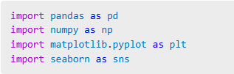
Libraries & Tools
Pandas, numpy – For data loading and processing
→ Used to manage, clean, and explore datasets.
Seaborn, matplotlib – For visualizing data
→ Help generate graphs like heatmaps and pairplots.
Sklearn – Optional, for ML models if required
→ Provides model-building and evaluation tools.

Slide 5
Data Preprocessing
Load dataset from CSV file
→ We use pd.read_csv() to load the data into a DataFrame.
Handle missing or null values
→ Dropping or filling nulls ensures clean input for analysis.
Encode any categorical data if present
→ Convert text labels into numbers for ML compatibility.

Slide 6
Data Exploration
Use .head(), .info( ), .describe( ) to inspect data
→ These functions give quick insight into the data's structure.
1
2
Identify outliers or inconsistencies
→ Essential for cleaning and preparing the data.
3
4
Understand feature types and ranges
→ Helps identify numeric vs. categorical features.
Box plots → excellent for spotting outliers.

Slide 7

Data Visualization
Use heatmaps and histograms to find correlations
→ Helps visualize relationships between features.
Plot distributions of features
→ Understand spread and central tendency of variables.
.
features.

Slide 8
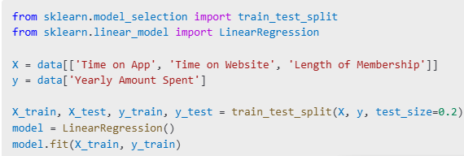
Model Preparation
Select features (X) and target variable (y)
→ Determine which columns will be used for training.
Use train_test_split to divide data
→ Keeps a part of data unseen for model evaluation.
Fit model (e.g., Linear Regression) if required
→ To test predictive power of preprocessed data

Slide 9

Conclusion
Data cleaning and exploration completed
→ Ensures better analysis and reliable modeling.
Visualizations revealed key trends
→ Helped understand important feature relationships.
Dataset is ready for ML model training
→ Final output is clean and structured.

Slide 10
THANK YOU

